Slide 1
Manufacturing IoT data analysis Beyond 5G H2020 project
András Benczúr
Technical director, Artificial Intelligence National Laboratory
head, Informatics Laboratory
Institute for Computer Science and Control
4 December 2020

Slide 2

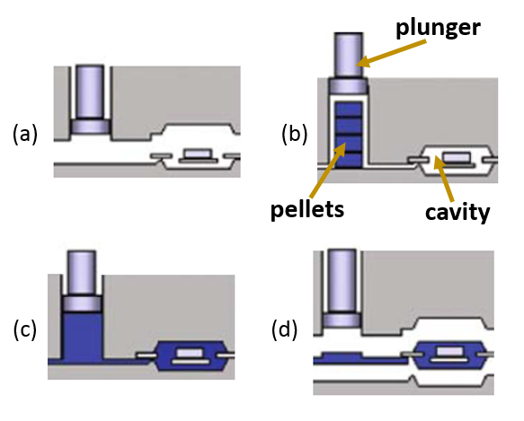
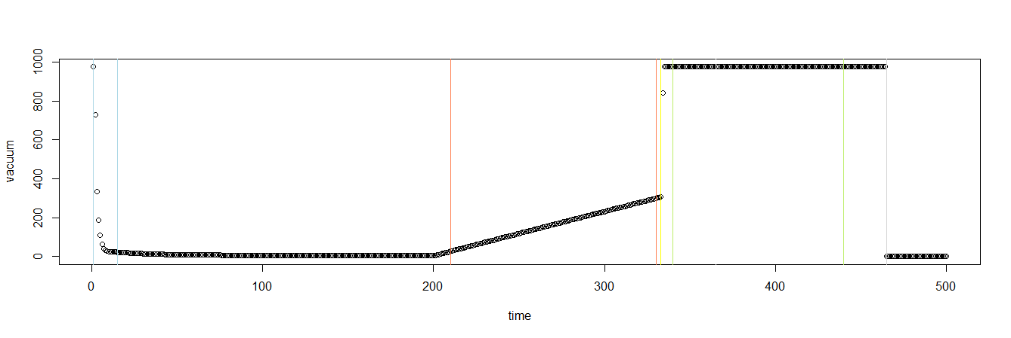
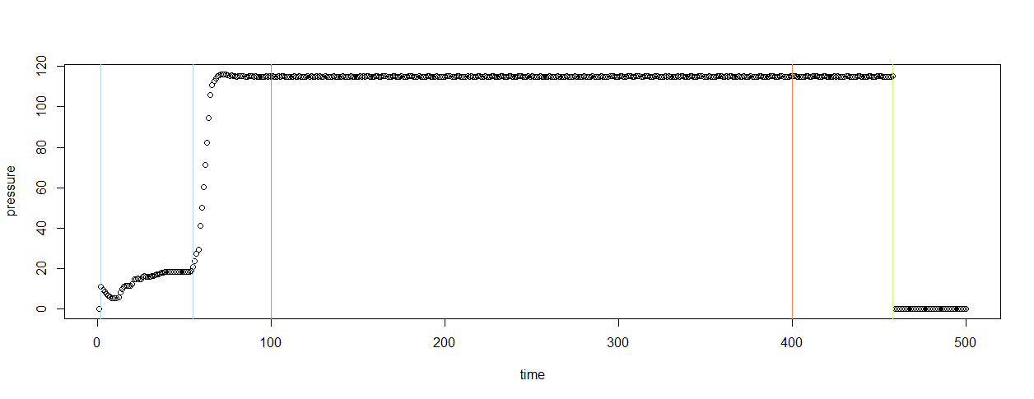
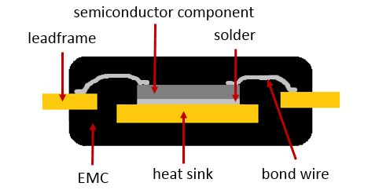
Scrap rate prediction in transfer molding
Electronic components are packaged in plastic to prevent from external damage
Failures (scrap) are air inside and delamination
Vacuum Pressure
Filling pressure
Transfer Pressure
Mándli, Anna, Róbert Pálovics, Mátyás Susits, and András A. Benczúr. "Time Series Classification for Scrap Rate Prediction in Transfer Molding.” 3rd SIGKDD Workshop on Mining and Learning from Time Series Held in conjunction with KDD'17 Aug 14, 2017 - Halifax, Nova Scotia, Canada

Slide 3
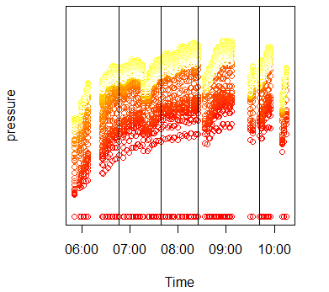
Scrap rate prediction in transfer molding
Multiple time series, 500+ measurements in each: many, many data points
Product sequence defines time series over the individual product time series
Features of mean, variance, differentials, distribution of pressure and temperature series
In the end, ~50 features in the final classification data
Product series
Individual product
Vacuum Pressure
Individual product
Transfer Pressure

Slide 4


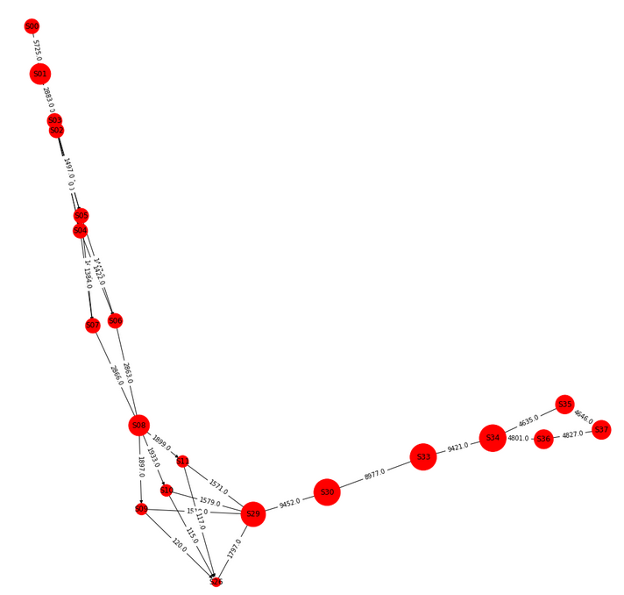
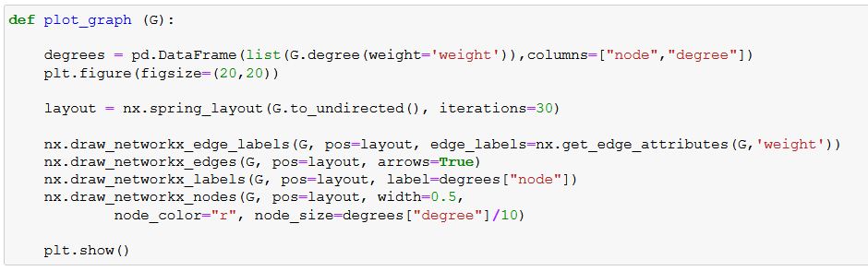
Bosch Kaggle Challenge (2017)
Scrap prediction for individual products
Numerical measurements
Categorical variables for settings
Timestamp, product ID, station ID
2.4M products from 30+ stations
Products can be followed by timestamp
Frequent edges of failed products on graph

Slide 5
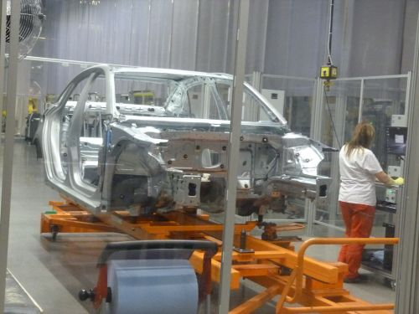
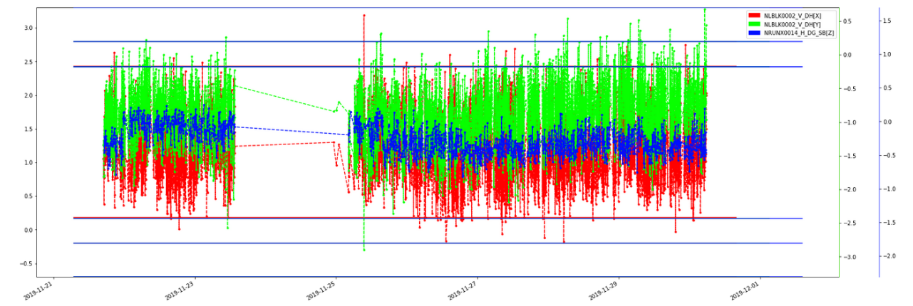
Product quality control - illustration
Example: can body measured during several steps of manufacturing
Measurements and limits available for extended period of time
Suitable for hypothesis testing for quality and robot positioning issues
Big data, 1000s of measurements for 1000000s of car bodies
Image Source: https://autopro.hu/gyartosor/a-legnagyobb-magyar-gyarban-jartunk-karosszeriauzem/148609

Slide 6

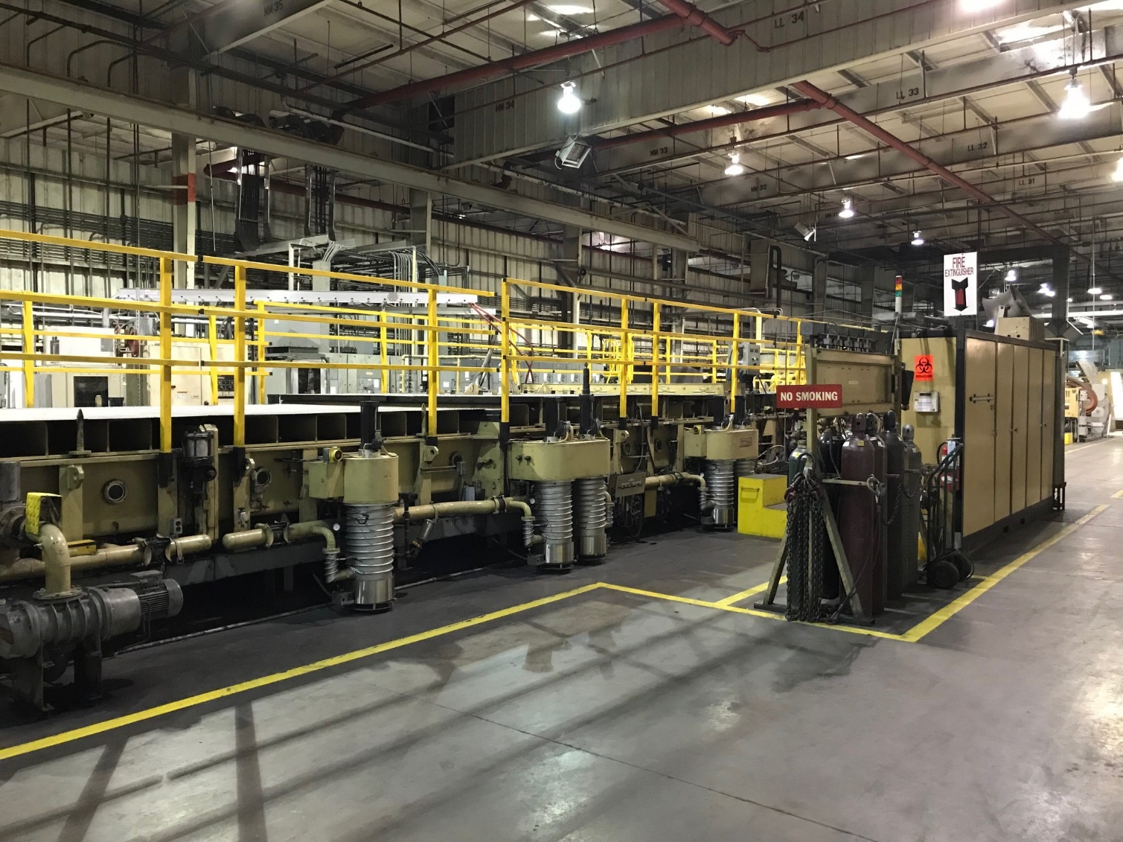
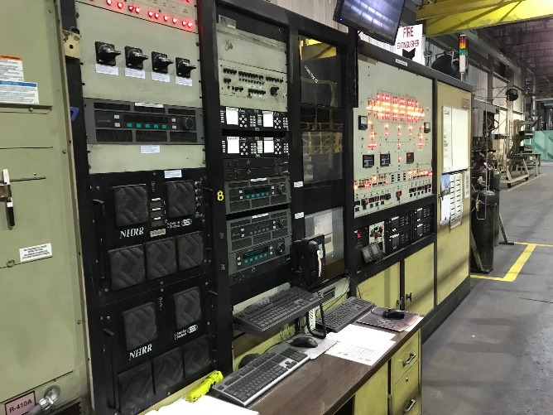
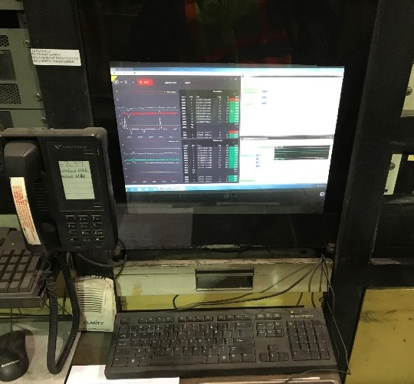
Glass Coating line
Power generators located across coating line from control console
Control console
Networking and Data collection HW inside of rear doors
Front of control console
Control PC
Ethernet cable

Slide 7
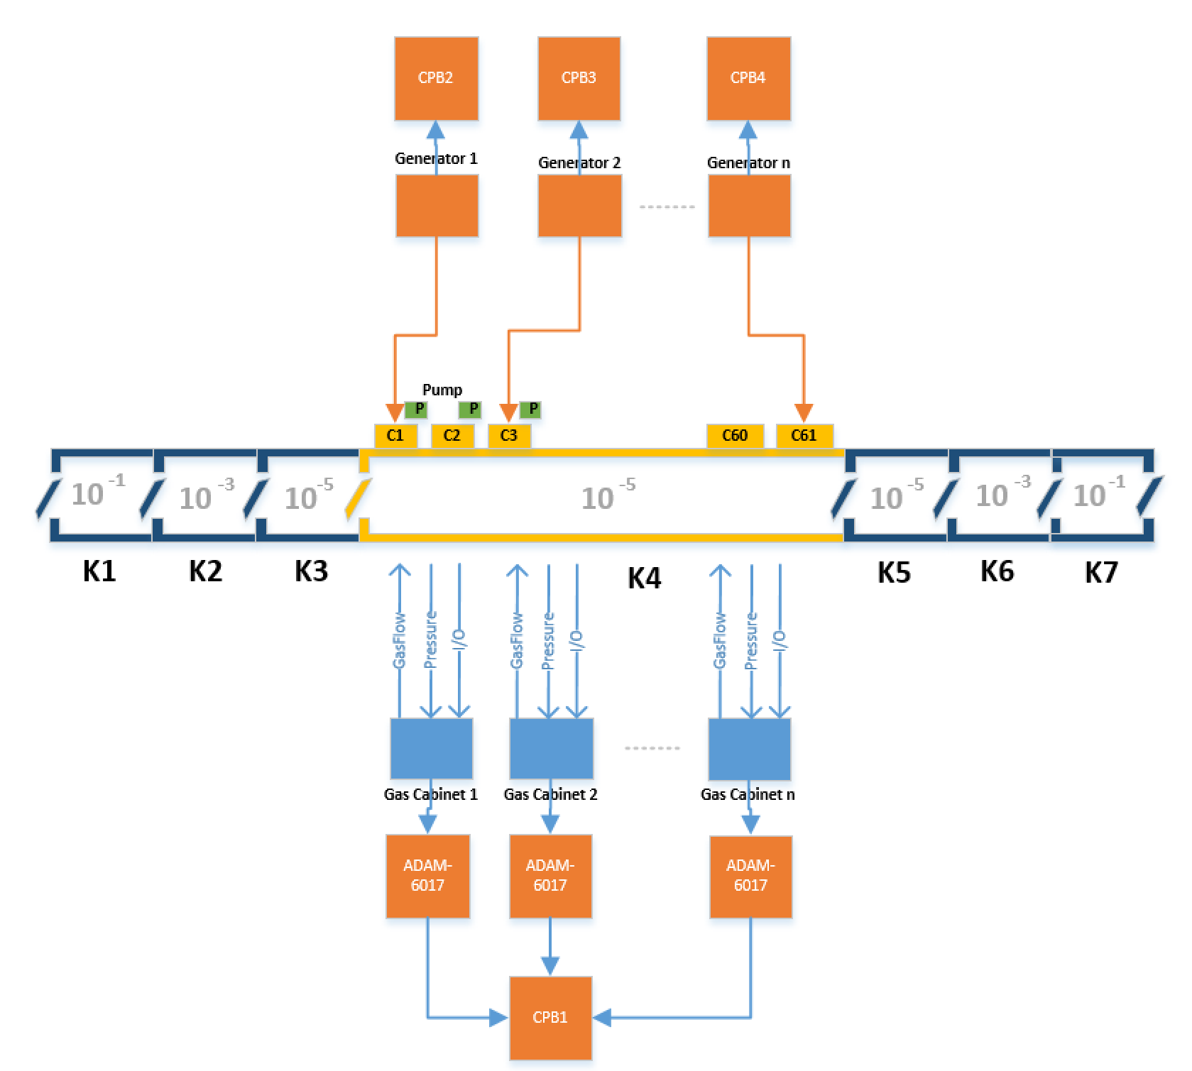
Euroglas: data from an entire chamber
Glass coating by various metals
Main active element is a silver layer
Several protective layers around
Chamber has 60+ compartments
A compartment can be responsible for a metal cathode or gas flow
Several products in a chamber at a time
Data
Power Generators (U, I, R) for plasma sputtering
9 x 4 Mass-flow controllers (Argon, Nitrogen)
Light color measurements on glass panel
RS - Reflection on Coating Side (“Reflexion Schichtseite”)
RG – Reflection on Glass Side (“Reflexion Glasseite”)
T - Transmission through the glass
In-Situ and ex-situ glass color measurements

Slide 8
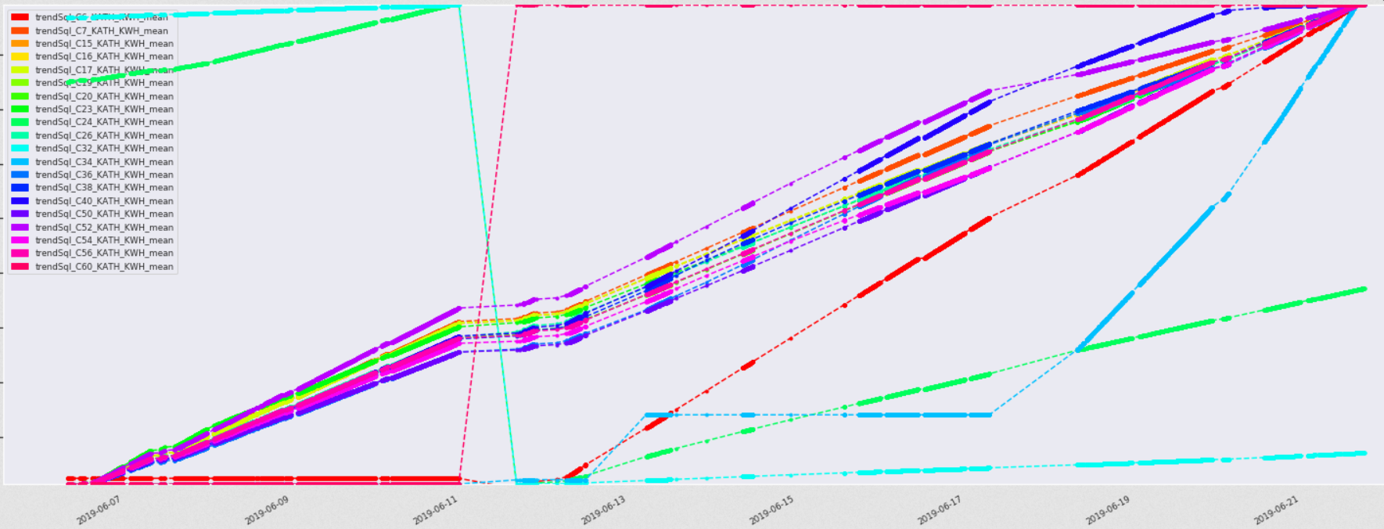
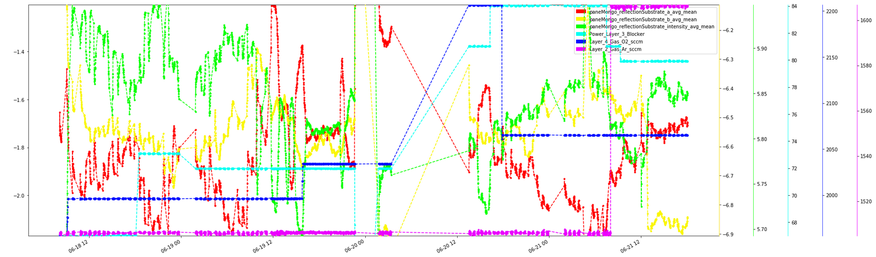
Complex process, compartments are maintained at different times
Several cathode changes (24,32,34)
- 24 is Silver, the main layer
C40 turned off at end
Significant changes in
Power Layer 3 (cyan)
O2 Layer 4 (blue)
Ar Layer 2 (purple)
Cathode lifetime

Slide 9
Is Industrial IoT different? In what sense it new?
Past industry practice:
Understand the process
Material, mechanical, optical, … engineering knowledge
Define operational set points, safety intervals
Look at best practices
Start production, measure end product quality
Collect data only with predefined purpose
Data collection may require hardware, interfaces, software, human interaction
If something goes wrong, start measuring
Little intermediate data exist to test hypotheses
Current progress
Software infrastructure is being built at the largest players (Bosch, Flex, Audi, etc) for mass data collection
Data driven (“Big Data”) approach becomes feasible
Usual data analysis tasks
Task is to predict an attribute, or find objects by attribute similarity
Simple table, objects described by attributes
Difficulty with industrial IoT data
A process can run for varying amount of time and periodically measure a few parameters – variable length
An object may go through several processes
The end product may be assembled from several sub-products, hierarchy of objects
Current trend
Try to dump everything into a deep neural net
Difficult to interpret, even if it is working
Too many parameters to tune, risk of generalization error
All these problems are unique and require domain knowledge

Slide 10
Beyond 5G H2020 Flagship
Nokia Solutions and Networks OY | FI
Ericsson AB | SE
Aalto University | FI
Atos Spain SA | ES
B-COM | FR
Chalmers Tekniska Högskola AB | SE
Commissariat à l'énergie atomique et aux énergies alt. | FR
Ericsson Araştırma, Geliştirme ve Bilişim Hizmetleri A.Ş. | TR
Ericsson Magyarország Kommunikációs Rendszerek Kft | HU
Institute for Computer Science and Control (SZTAKI) | HU
Intel Deutschland GmbH | DE
Nextworks S.R.L. | IT
Nokia Solutions and Networks GmbH & Co. KG | DE
Orange | FR
Politecnico di Torino | IT
Qamcom Research and Technology AB | SE
Siemens Aktiengesellschaft | DE
Technische Universität Dresden | DE
Technische Universität Kaiserslautern | DE
Telecom Italia S.p.A. | IT
Telefónica Investigación y Desarrollo S.A.U. | ES
Universidad Carlos III de Madrid | ES
University of Oulu | FI
University of Pisa | IT
Wings ICT Solutions PC | GR

Slide 11
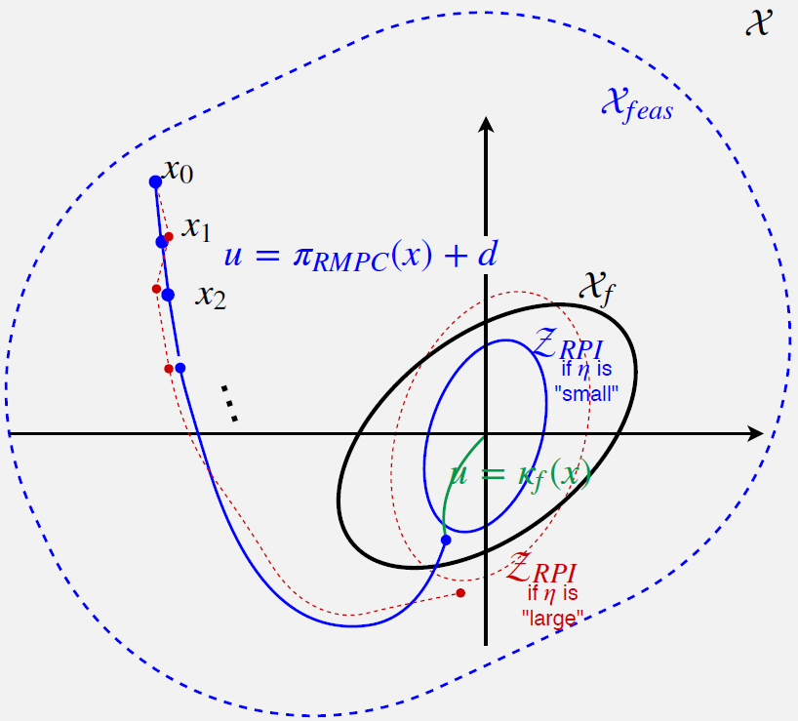
Model Predictive Control (MPC)
Deep Learning based control mechanism to handle various optimization tasks to assist complex rule-based systems.
Design evaluation in optimal resource allocation problems emerging in, e.g., MIMO antenna systems.
We train the machine learning techniques based on simulated or measurement data from partners.
New real-time, on-line machine learning MPC methods suitable for concept drift detection, e.g., reconfigure MIMO network nodes in real-time
MPC by neural networks and Gaussian processes; attention-based models to dynamically identify important parts of the input

Slide 12
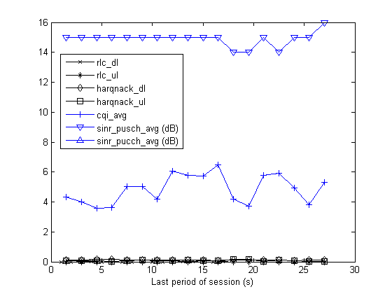
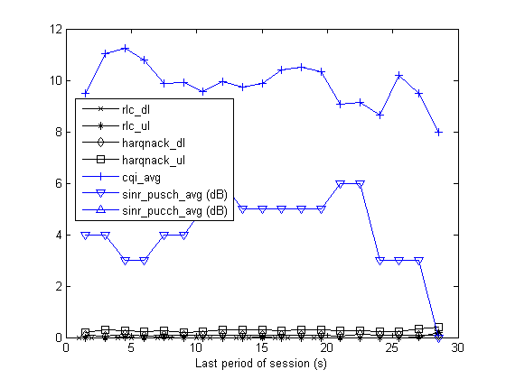
Radio Session Drop prediction in eNodeB CELLTRACE logs from a live LTE (4G) network
RRC connection setup / Successful handover into the cell
UE context release/ Successful handover out of the cell
START
END
Daróczy, Bálint, Péter Vaderna, and András Benczúr. "Machine learning based session drop prediction in LTE networks and its SON aspects." Vehicular Technology Conference (VTC Spring), IEEE, 2015.
Per UE measurement reports (RSRP, neighbor cell RSRP list)
Configurable period Not available in this analysis
Per UE traffic report (traffic volumes, protocol events (HARQ, RLC))
Per radio UE measurement (CQI, SINR)
Period: 1.28s
High quality
Low quality
Notes:
eNodeB Event logs (celltrace) are parsed and correlated to constitute RAB sessions

Slide 13
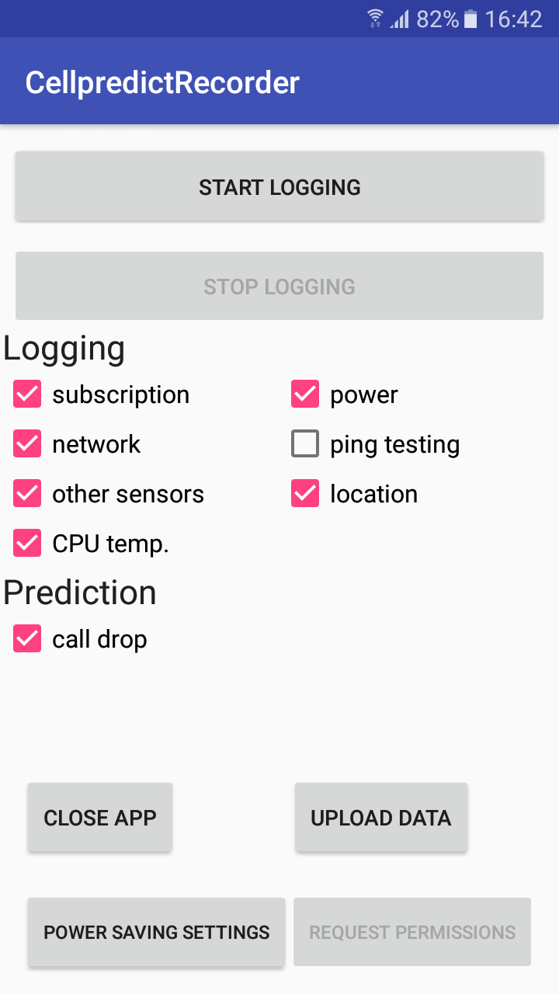
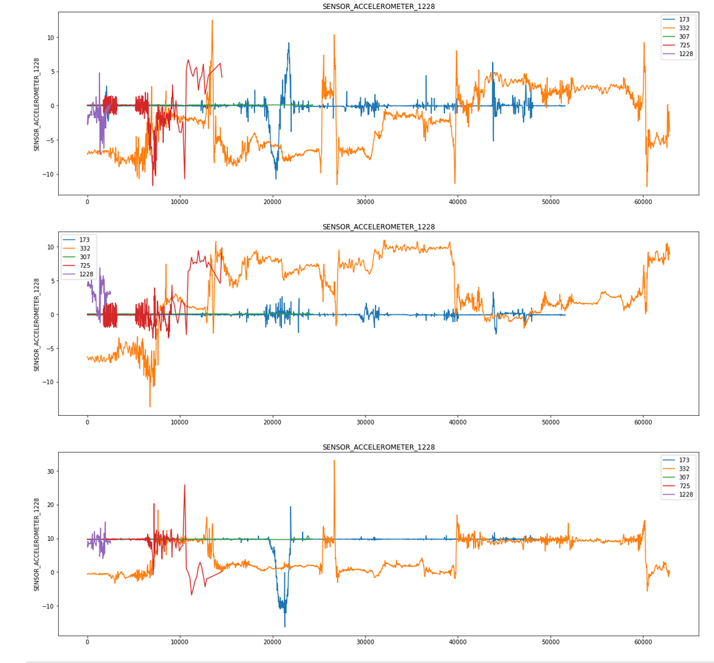
Smartphone sensor processing – our logging app
Logged whenever they change:
Cell info, signal strength
Network and Wi-Fi connectivity
Telephony call and data activity
Sensors: accelerometer, magnetic, gyroscope, light, pressure, proximity, gravity, humidity, temperature, battery, CPU and battery temperature
GPS and network based location
Network quality: ping test results, time and loss; data packet counts, Facebook net quality API etc.
Accelerometer
Acc X
Acc Y
Acc Z
Time (ms)

Slide 14
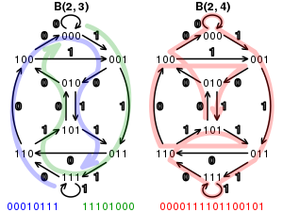
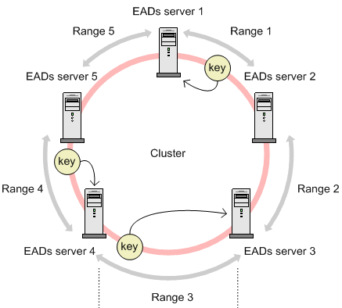
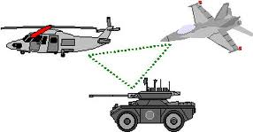
B5G proposal: Network topologies for distributed ML
Fully decentralized learning
Only model updates are sent to peers
Network topologies: hypercubic networks, consistent hashing
Measurement
ΔQ
R ≈ P₁Q₁
ΔQ
R ≈ P₂(Q₂+ΔQ)
Li, J., Jannotti, J., De Couto, D. S., Karger, D. R., & Morris, R. (2000, August). A scalable location service for geographic ad hoc routing. In/Proceedings of the 6th annual international conference on Mobile computing and networking/ (pp. 120-130). ACM.
A Benczúr, U Glässer, T Lukovszki. Formal description of a distributed location service for mobile ad hoc networks. International Workshop on Abstract State Machines, 204-217 (2003)
I Hegedűs, Á Berta, L Kocsis, AA Benczúr, M Jelasity. Robust decentralized low-rank matrix decomposition. ACM Transactions on Intelligent Systems and Technology (TIST) 7 (4), 62 (2017)

Slide 15
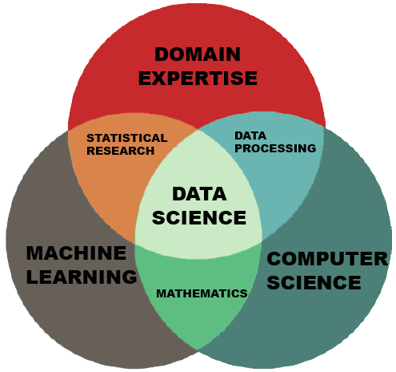
Summary
Process sensor analysis tasks
Scrap rate
Quality control
Explain, understand
Hierarchical structure
Multiple sources, difficult to identify events
Lots of table joins
Approaches
Agile visualization and modeling, Jupyter notebooks
Summary of difficulties
Every problem is different and require domain knowledge
Events spread in time in multiple data sources
Time series with metadata
Collaboration and productization difficulty with Jupyter notebooks
Transfer molding
Glass coating, Plasma Abatement
Radio quality

Slide 16
Questions?
Thank You!

