Slide 1

Agyi génexpressziós mintázatok elemzése mRNS és elektrofiziológiai adatok alapján
Hangya Balázs
Lendület Rendszer-neurobiológia Kutatócsoport, Kísérleti Orvostudományi Kutatóintézet
MILAB, 2020

Slide 2
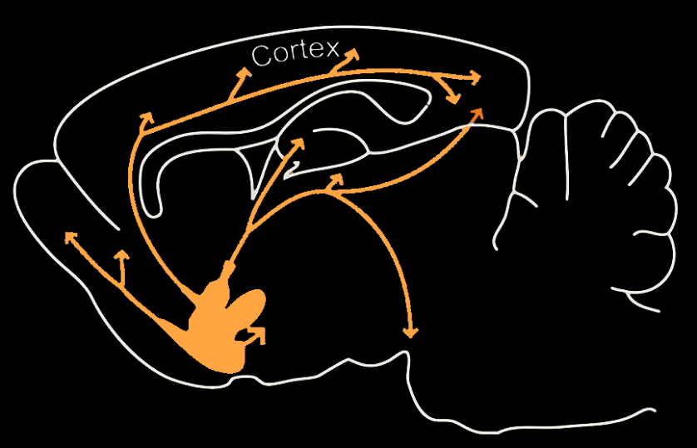
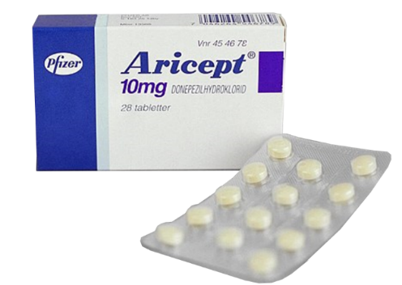
The basal forebrain cholinergic system
Normal function
Arousal
Attention
Learning
Consciousness
Dysfunction – neurodegenerative dementias
Alzheimer’s disease
Parkinson’s dementia
Age-related cognitive decline

Slide 3
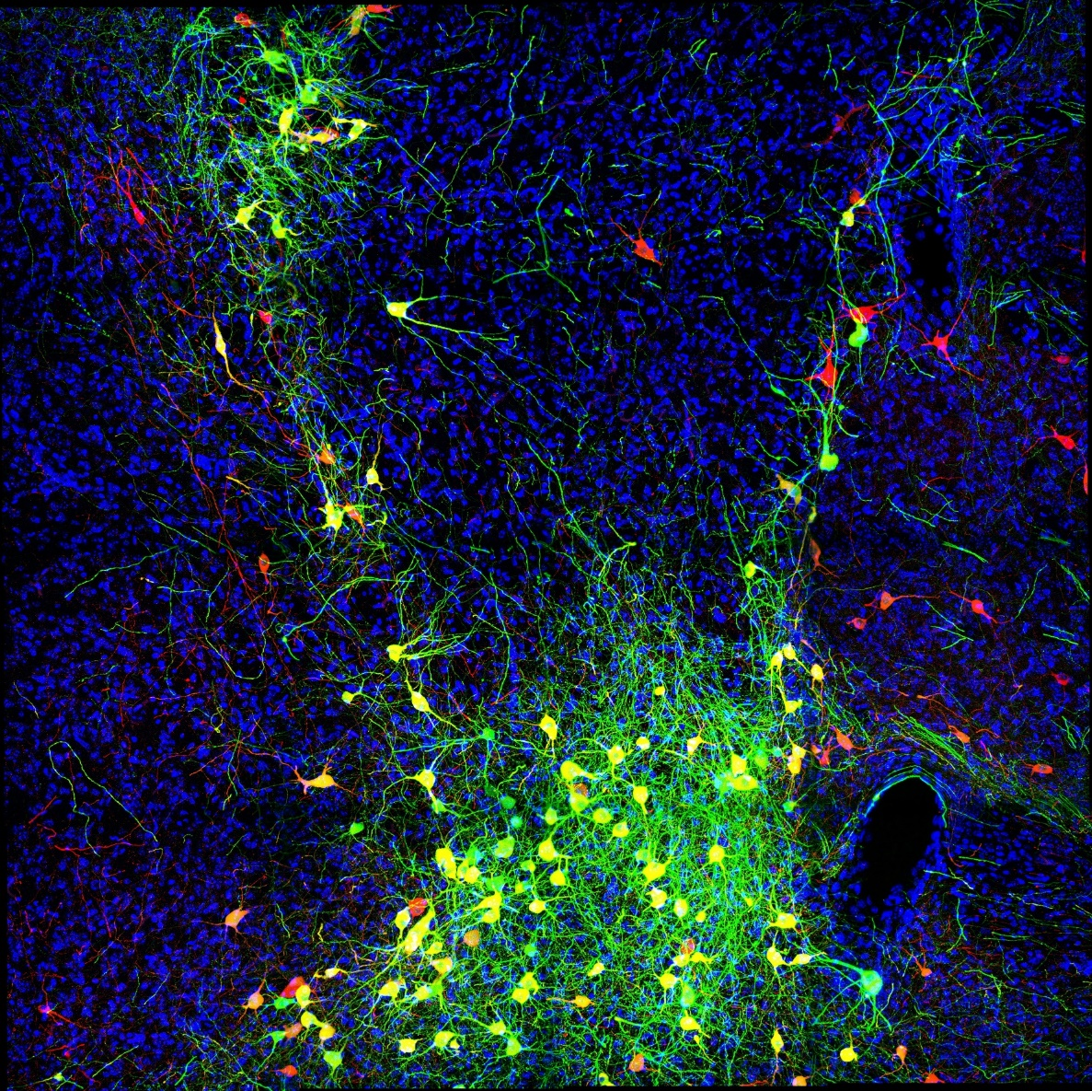

Studying mouse brain cells during learning
ChAT
ChETA-eYFP

Slide 4
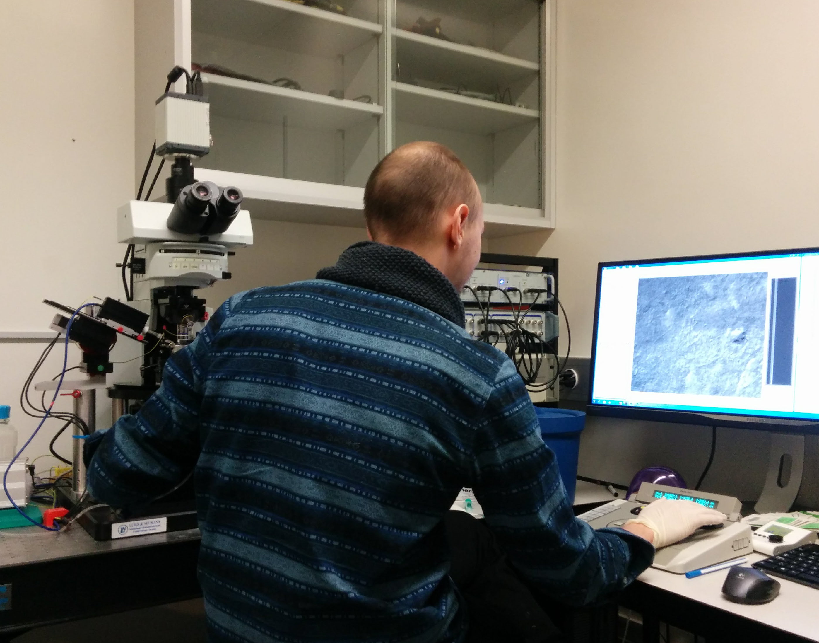
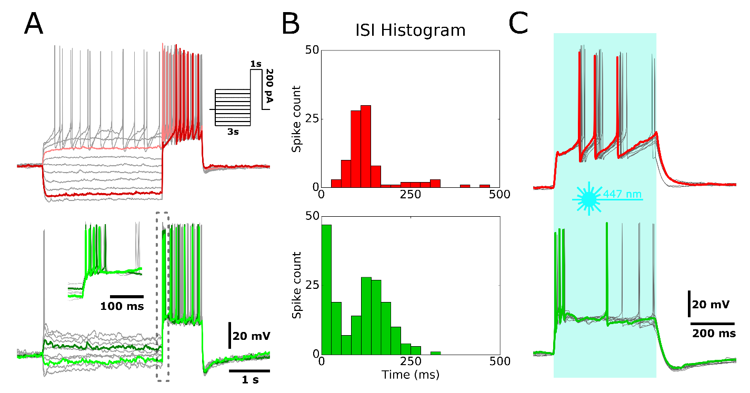
Two types of cholinergic neurons
Dániel Schlingloff
Attila Gulyás
Early- and Late firing cholinergic cells in the basal forebrain

Slide 5
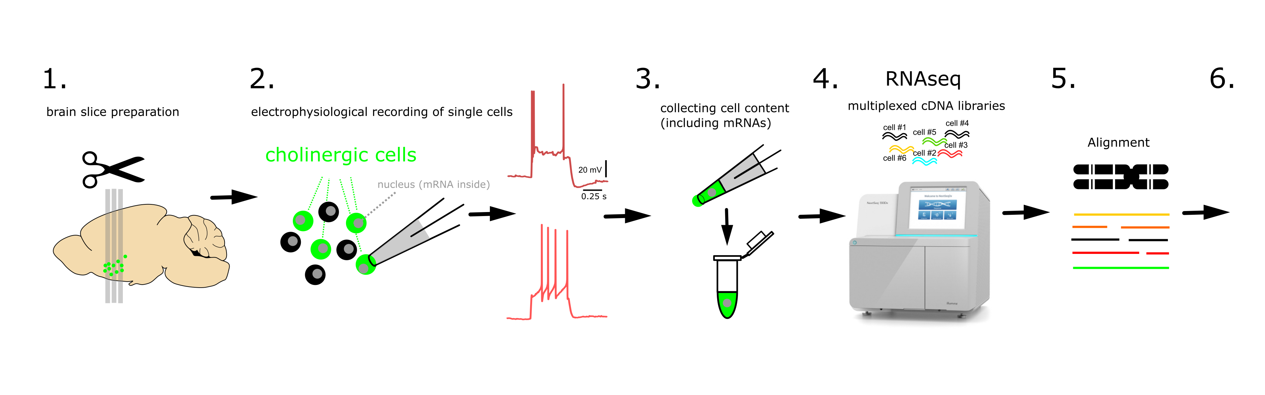
Investigating mRNA expression
Our dataset:
80+ single cells
30+ electrophysiological features (for each cell)
11000+ genes (expression levels for each cell)

Slide 6
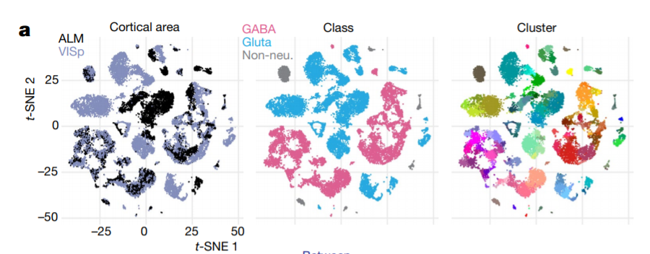
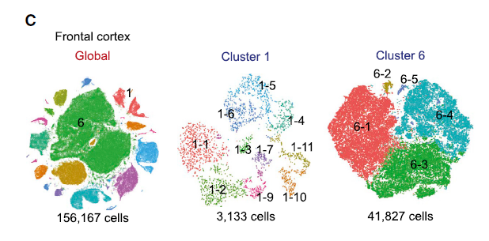
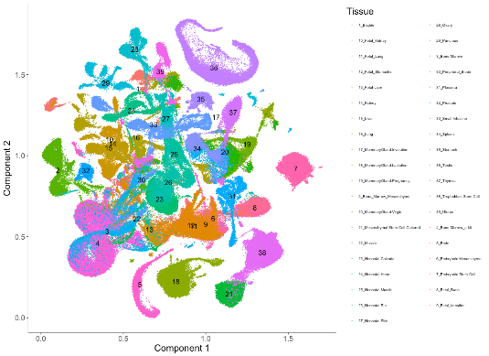
Dimensionality reduction
T-distributed Stochastic Neighbour Embedding (t-SNE)
Tasic, 2018, Nature
Saunders, 2018, Cell
DropViz dataset
Uniform Manifold Approximation and Projection (UMAP)

Slide 7
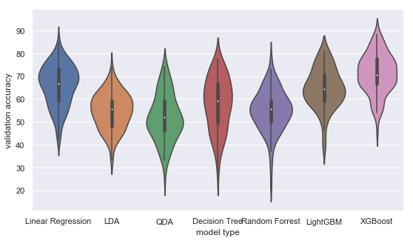
Classification
Gergő Szabó

Slide 8
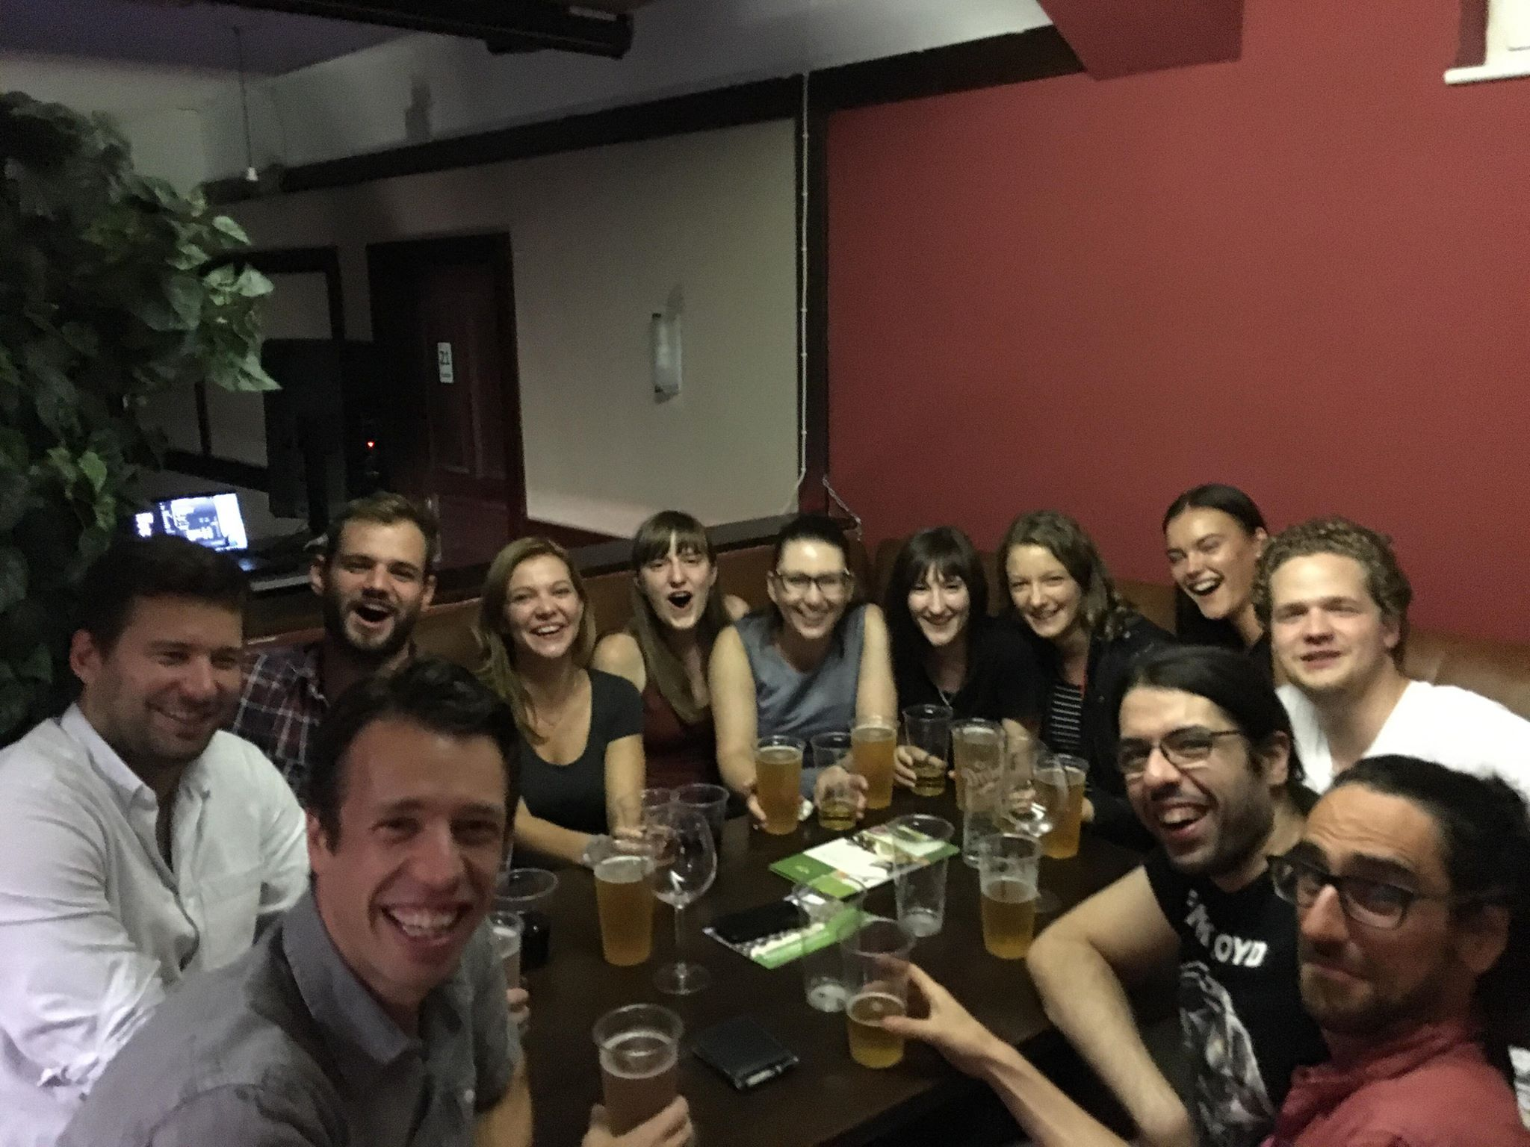



hangyalab
Katalin Lengyel
Nicola Solari
Sergio Martinez-Bellver
Konstantinos Lygdas
Panna Hegedüs
Dániel Schlingloff
Bálint Király
Márton Kajtor
Anna Velencei
Vivien Pillár
földylab
Lin Que
David Lukachevich
Tamas Lukachevich
Csaba Földy

